Slide 1
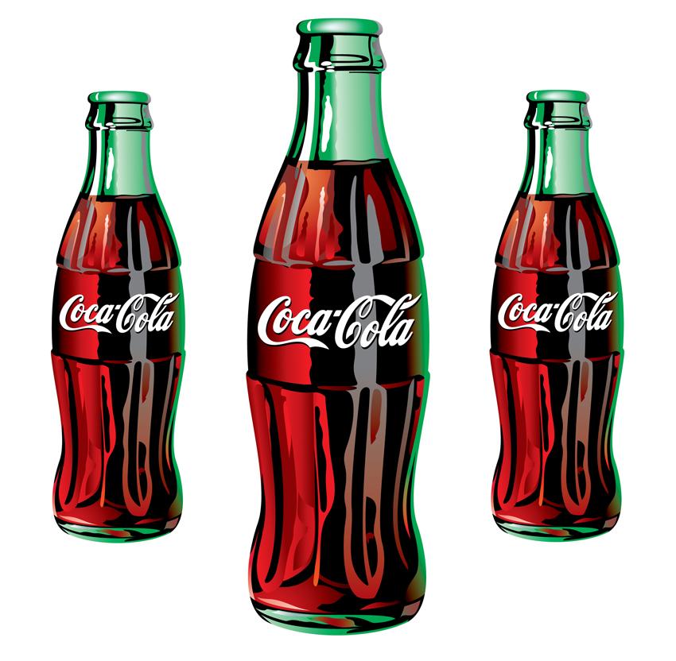
Coca Cola Bottling
MGMT 120

Slide 2
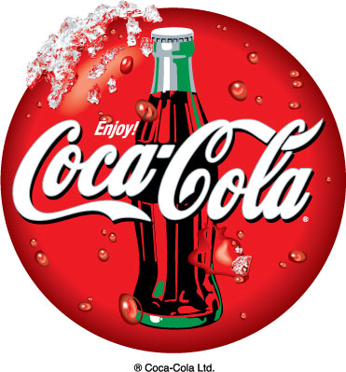
Company Profile
Originated as Soda fountain beverage in 1886
It is produced by The Coca Cola Company in Atlanta, Georgia.
Often known as Coke
The company produces concentrate, then sold to licensed Coca-cola bottlers. One of the largest Coca-Cola bottlers is Coca-Cola Enterprises

Slide 3
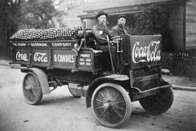
History of bottling
1894 (A modest start for a bold idea)
Biederharn began bottling Coca-Cola to sell, using a common glass bottle called a Hutchinson.
1899 (The first bottling agreement)
Two young attorneys, Thomas and Whitehead obtained exclusive rights to bottle Coca-Cola

Slide 4
History of bottling cont’d
1950s (Packaging Innovations)
Consumers had choices of package size and type.
Traditional 6.5-ounces contour bottle, or larger servings 10-,12- and 26-ounce version.
Cans were also introduced, becoming generally available in 1960.

Slide 5
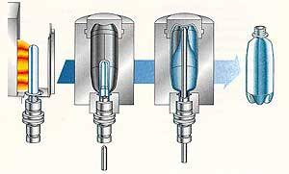
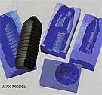
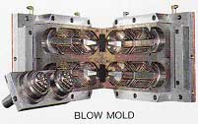
Manufacturing Bottle Operation
PET STRETCH BLOW MOULDING MACHINES

Slide 6
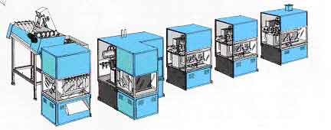
BASIC CONCEPT
PET machines typically comprise the following five modules :
Pre-form Feeder
Pre-form Insert and Bottle Discharge
Heating Unit
Heating and Pre-form Transportation
Blow Molding

Slide 7
Pre-form heating
Pre-form is introduced into the mold and closing the unit
Insert the stretching rod
Stretching and pre-blowing
Final bottle blowing
Molds open
Finished bottle discharge from the mold

Slide 8
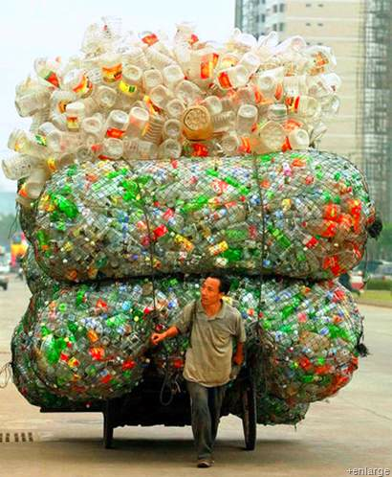
Plastic Bottles Pollution
In America, 60 millions plastic bottle are disposed a day
From manufacturing the plastic bottles massive amounts of greenhouse gases are produced
Plastic bottles take 700 years to begin composting
90% of the cost of bottled water is due to the bottles
24 million gallons of oil are needed to produce a billion plastic bottles

Slide 9
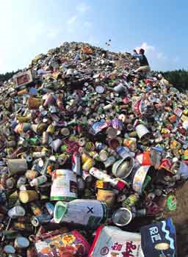
Aluminum Can Pollution
An aluminum can that is thrown away will still be a can 500 years from now!
The 36 billion aluminum cans landfilled last year had a scrap value of more than $600 million.

Slide 10
Solutions
Packaging
PlantBottle
Eco-friendly light weight bottle
Recycling plant
Recycling bin made from recycled PET
Crush Eco

Slide 11
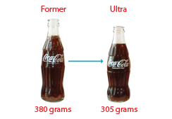
1. Packaging (Reduce)
Focus on life-cycle management – the use of high value recyclable materials and reusable packages.
Packaging made from polyethylene terephthalate (PET) plastic, aluminum, glass and steel. The materials are 100% recyclable.
Sustainable design efforts known as e3, focuses on improving efficiency, life cycle effectiveness and eco-innovation.

Slide 12
1. Packaging (Reduce) cont’d
The Ultra Glass contour bottle is designed in year 2000 to improve impact resistance, and reduce weight and cost.
The use has eliminated 52,000 metric tons of glass - reduction of 26,000 tons CO2 = planting 8,000 acres of trees.
Rolled out a short height closure – enable to reduce plastic use by 5%.
Also, reduce material trough development of closures without liners.

Slide 13
1. Packaging (Recover)
Approximate of 85% of unit case volume is delivered in recyclable bottles and cans.
Recovery of the containers and their materials for reuse.
Target – to recover directly 50% of the equivalent bottles and cans sold worldwide.

Slide 14
1. Packaging (Reuse)
Cans and Bottles
Using recycled content PET in more than 17 markets around the world.
Recycling plastic for reuse yields financial benefits, requires less energy and reduces waste and greenhouse gases.

Slide 15
1. Packaging (Reuse) cont’d
Bottle Caps
The bottle caps are 100% recyclable and are made from high-density materials selected for compatibility with most recycling systems.
Recycling Plants
Invested in building PET recycling plants that produce bottles from recycled content.

Slide 16
2. PlantBottle
Up to 30% plant based material mix with traditional PET plastic.
The plant-based material is made from sugar cane and molasses.
Reducing material use, increasing recycling, using more recycled content and advancing innovative technologies are some ways to reduce environmental carbon footprint.
plantBottle is introduced for which goal that to develop recyclable plastic bottles made form 100% plant-waste, which is to turn waste into a resource.

Slide 17
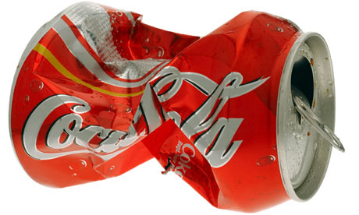
3. Eco-friendly Bottle
In April 2010, Coca-Cola China had launched Eco-friendly light weight.
The innovative new ultra-light bottle is the lightest bottle and reduces the carbon footprint by 35% .
Also, the bottle is designed to be easily twisted and compressed after being used. Thus saving more than 70% of the space.

Slide 18
4. Recycling Plant
The world’s largest plastic-bottle-to-bottle recycling plant
Held in Spartanburg, S.C. in January 2009.
Coca-Cola announced the launch of a multi-million dollar “Give it back” recycling campaign – recycle and reuse all of Coca-Cola bottles and cans.
The plant will produce approximately 100 million lb of food-grade recycled PET plastic each year.
Over the next ten years, the plant will avoid the release of 1million metric tons of CO2 emissions.

Slide 19
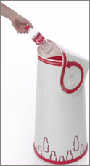
5. Recycling Bin
Made from recycled PET for recycling aluminum cans and PET Bottles.
Was designed to stand out visually. Also, clearly communicating the benefits of recycling.
Produced the bin using PET to reinforce the connection between the Coca-Cola products and recycling.
Had ordered 300 bins from Atlanta-based manufacturer for Earth Day (April 22)

Slide 20
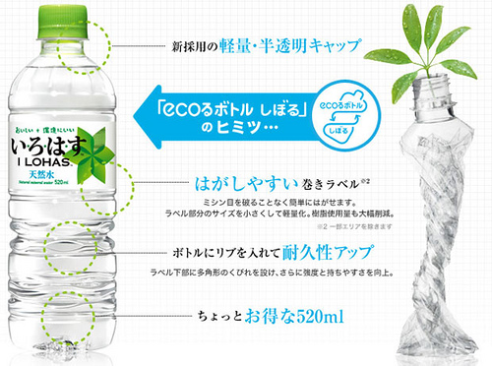
6. Crush Eco
A new ultra-light “crushable” plastic bottle that weight 40% less than regular PET packaging launched by Coca-Cola Japan.

Slide 21
6. Crush Eco cont’d
The label size is reduced to save in materials. Also, the water is sourced from places close to the plant to reduce CO2 emissions from transportation.
The campaign featured a street art project than turned the crushed bottles into “art” rather than rubbish.
Crush Eco video: http://video.thecoca-colacompany.com/presscenter/avcenter/view/sustainability/crush-eco

Slide 22
Word Cited
Coca-Cola. (n.d.). Coca-Cola. Retrieved May 24, 2010, from http://en.wikipedia.org/wiki/Coca-Cola
Coca-Cola - Our Company - The Coca-Cola System - History of Bottling. (n.d.). Coca-Cola: The Coca-Cola Company. Retrieved May 24, 2010, from http://www.thecoca-colacompany.com/ourcompany/historybottling.html
Bottled Water - Bottled Water Problems - Bottle Water Alternatives. (n.d.). Bottled Water - Bottled Water Problems - Bottle Water Alternatives. Retrieved May 26, 2010, from http://www.bottledwaterblues.com/
Doug. (n.d.). Plastic Bottle Facts Make You Think Before You Drink | greenUPGRADER. greenUPGRADER. Retrieved May 26, 2010, from http://greenupgrader.com/3258/plastic-bottle-facts-make-you-think-before-you-drink/

Slide 23
"Glass Bottle Making By The Process Of Blow Molding And Annealing." Wise Dude - He's got the answers to your questions. N.p., n.d. Web. 26 May 2010. <http://www.wisedude.com/science_engineering/bottles.htm
Chia Ming's Services and Q&A about Stretch / Injection / Extrusion Blow Molding. (n.d.). Blow Molding Machine Manufacturer - Chia Ming Machinery. Retrieved May 25, 2010, from http://www.cm-pet.com.tw/services.ht
Airmax System: Screw Compressors. (n.d.). Airmax System Co., Ltd.. Retrieved May 25, 2010, from http://www.airmaxsystem.com/petcompressed%20air%20system%20design.htm
Coca-Cola - Sustainability - Protecting the Environment - Sustainable Packaging - Package Design. (n.d.). Coca-Cola: The Coca-Cola Company. Retrieved May 26, 2010, from http://www.thecoca-colacompany.com/citizenship/package_design.html
Coca-Cola - Sustainability - Protecting the Environment - Sustainable Packaging - Package Material Reuse. (n.d.). Coca-Cola: The Coca-Cola Company. Retrieved May 26, 2010, from http://www.thecoca-colacompany.com/citizenship/package_material_reuse.html
Recycling Facts. (n.d.). College of Arts and Sciences & Conservatory of Music - Oberlin College. Retrieved May 25, 2010, from http://www.oberlin.edu/recycle/facts.html

Slide 24
Sustainable Product Packaging & Recycling: The Coca-Cola Company. (n.d.). Coca-Cola: The Coca-Cola Company. Retrieved June 1, 2010, from http://www.thecoca-colacompany.com/citizenship/packaging.html
Coca-Cola - Our Company - Innovation - In our Marketing. (n.d.). Coca-Cola: The Coca-Cola Company. Retrieved May 26, 2010, from http://www.thecoca-colacompany.com/ourcompany/innovation_marketing.html
China Light Weight Bottle - Press Release - Coca-Cola. (n.d.). Coca-Cola: The Coca-Cola Company. Retrieved May 26, 2010, from http://www.thecoca-colacompany.com/presscenter/nr_20100426_china_lightweight_bottle.htm
Bottle-to-Bottle Recycling Plant - Press Release - Coca-Cola. (n.d.). Coca-Cola: The Coca-Cola Company. Retrieved June 1, 2010, from http://www.thecoca-colacompany.com/presscenter/nr_20090114_bottle-to-bottle_recycling.htm
Coca-Cola - Sustainability - Protecting the Environment - News - Coca-Cola Recycling Bin Wins Prestigious Design Award. (n.d.). Coca-Cola: The Coca-Cola Company. Retrieved May 28, 2010, from http://www.thecoca-colacompany.com/citizenship/environmental_news_recycling _bin_red_dot_award.htm

