Slide 1
Brooks Case Competition
By: Joey McNamara, Jack Grotenhuis, Sam Sturtzer & Andrew Copeland

Slide 2
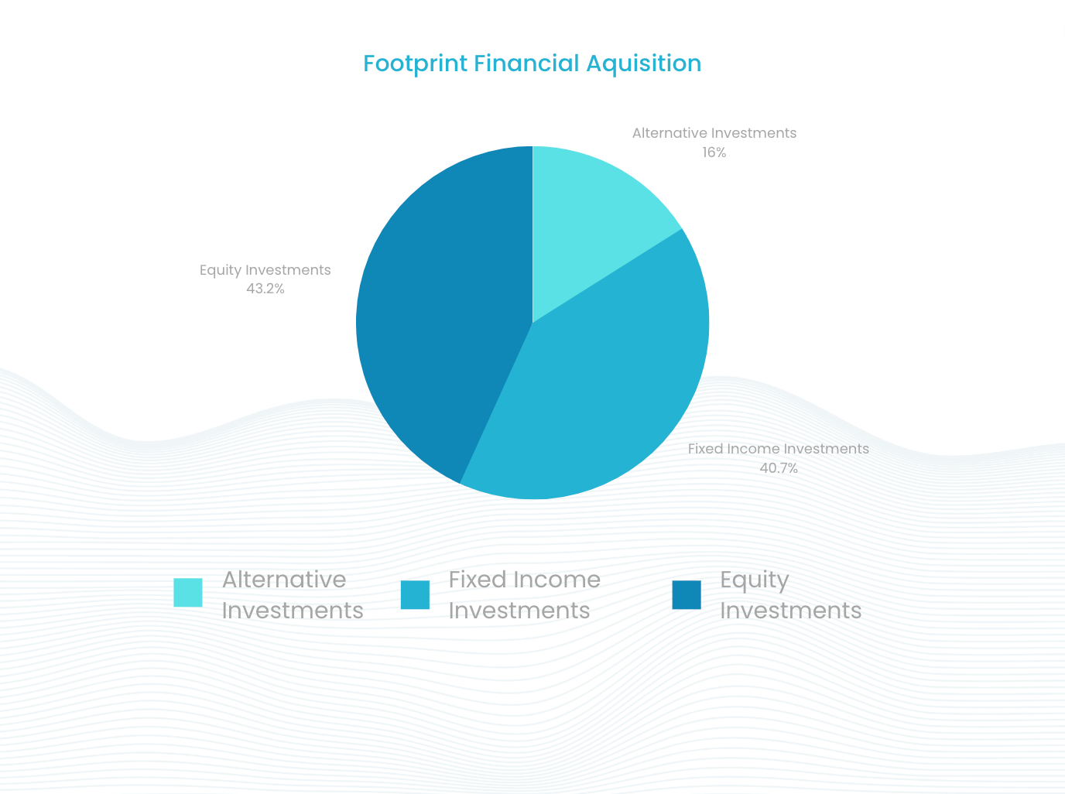
Recommendation

Slide 3
ESG Impact
Climate Risk Management
Diversity, Equity, & Inclusion
Sustainable investment options

Slide 4
Culture
Strategy
Values
Notes:
Joey

Slide 5
Finances
Discounted Cash Flow Analysis
Comparable Valuation
Growth Rates of Variables
Notes:
Davis

Slide 6
Thank you, any questions?

