Slide 1

Brooks case competition
Jeremy Schifris, Reid Jarvis, Josh Patterson, Dew Veeraphan

Slide 2
Our recommended solution for M&A

Slide 3
ESG Strategy

Slide 4
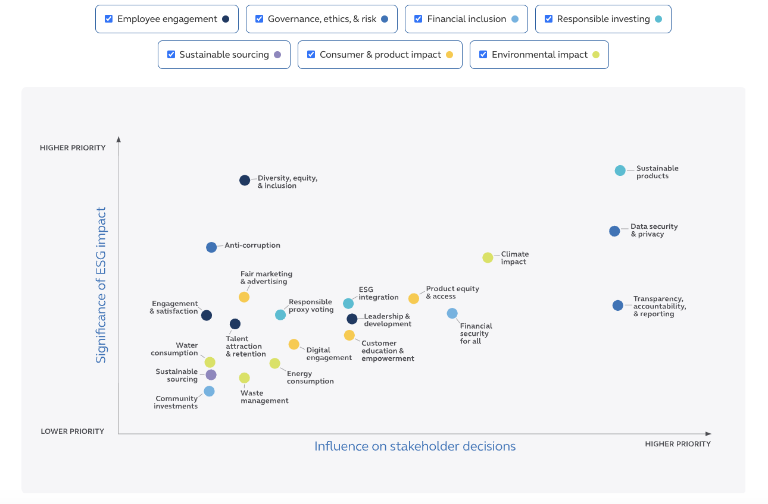
ESG Strategy
Global inclusion in finance
Align the target with UN SDGs
Double the number of financial inclusion for women own business and people of color
By 2035 Principal will reduce U.S. carbon emission and in 2050 we will become carbon neutral
Notes:
https://www.principal.com/sustainability/

Slide 5
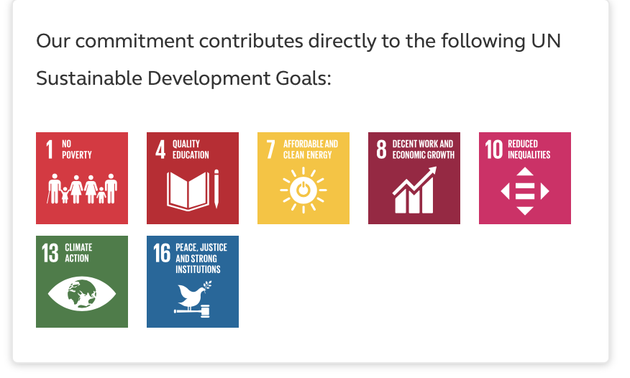
ESG GOALS
Looks for businesses with good environmental, social, and governance policies
Reduce carbon impact and promoting gender diversity
Has a line of environmentally friendly investment solutions
Sustainable Future Funds invest in businesses with high corporate governance, social responsibility, and environmental sustainability
The funds invest in businesses offering solutions to global problems like poverty, resource depletion, and climate change

Slide 6
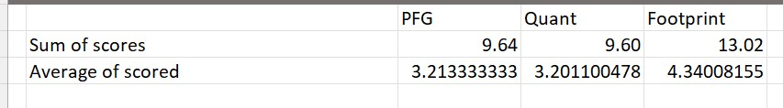
Principals ESG Solution
The acquisition of Footprint fits well with PFG's objectives to promote sustainable practices and businesses with high ESG performance
Footprint has a proven track record of successfully incorporating ESG analysis into its investment process and building a portfolio with high ESG scores

Slide 7
Cultural fit

Slide 8
Customer Based Service
Principals' commitment to putting customers first
Quant's assets comprised of only 12% retail investors
Footprint's assets comprised of 34% retail investors, 17% small-medium businesses

Slide 9
Key employee turnover
Quant has lost 3 key fund managers recently
2 left for unexpected reasons
Potential cultural problems

Slide 10

Financial Analysis

Slide 11
Beta and WACC
Quant: Footprint:
Calculations based off portfolio benchmarks, shown in report
Assumptions
Interest Rate on Debt | 3.95%
Effective Tax Rate | 13.70%
Risk Free Rate | 4.50%
Spread Indication | 3.25%
Market Risk Premium | 4.50%
Beta | 0.893101933
Assumptions
Interest Rate on Debt | 3.95%
Effective Tax Rate | 13.70%
Risk Free Rate | 4.50%
Spread Indication | 3.25%
Market Risk Premium | 5.50%
Beta | 0.997085395
Debt | (128.04) |  | Re | 4.50%
Cash | 99.87 |  | Rd | 3.95%
E/V | 1.76
D/V | -0.763571301 |  | WACC | 5.33%
Debt | (224.34) |  | Re | 5.50%
Cash | 126.71 |  | Rd | 3.95%
E/V | 2.21
D/V | -1.208694185 |  | WACC | 8.021%

Slide 12
Growth rates of key variables
Quant: Footprint:
Average of each growth rate
Little historical data to pull from
Not an effective indicator when looking at future growth
 | 2021-2022 | 2022-2023 | Average
Growth Rate Total Revenue | -38.57% | 47.15% | 4.29%
Growth Rate Total Expenses | -20.00% | 5.00% | -7.50%
Growth Rate Net Income | -55.51% | 116.25% | 30.37%
Growth Rate Net Assets | -31.05% | 55.17% | 12.06%
 | 2021-2022 | 2022-2023 | Average
Growth Rate Total Revenue | -37.35% | 28.97% | -4.19%
Growth Rate Total Expenses | -20.00% | 5.00% | -7.50%
Growth Rate Net Income | -52.71% | 64.89% | 6.09%
Growth Rate Net Assets | -40.13% | 25.97% | -7.08%

Slide 13
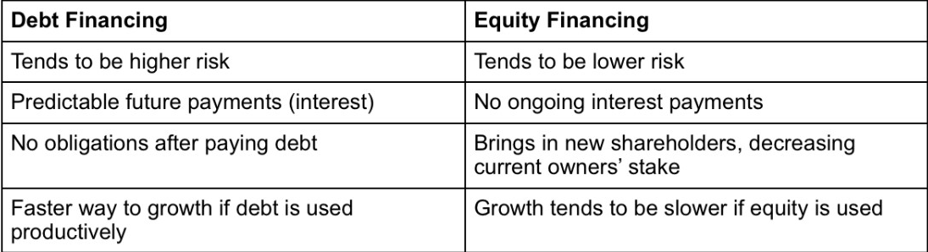
Financing options pros and cons

Slide 14
Return on equity and return on asset
Footprint
Quant
Notes:
We use Dupont ROE to find the ROE

Slide 15
Bid Pricing
DCF models suggest 481 million for Footprint
Quant has a suggested price of 366 million
Operating cash flow divided by the expected rate of return

Slide 16
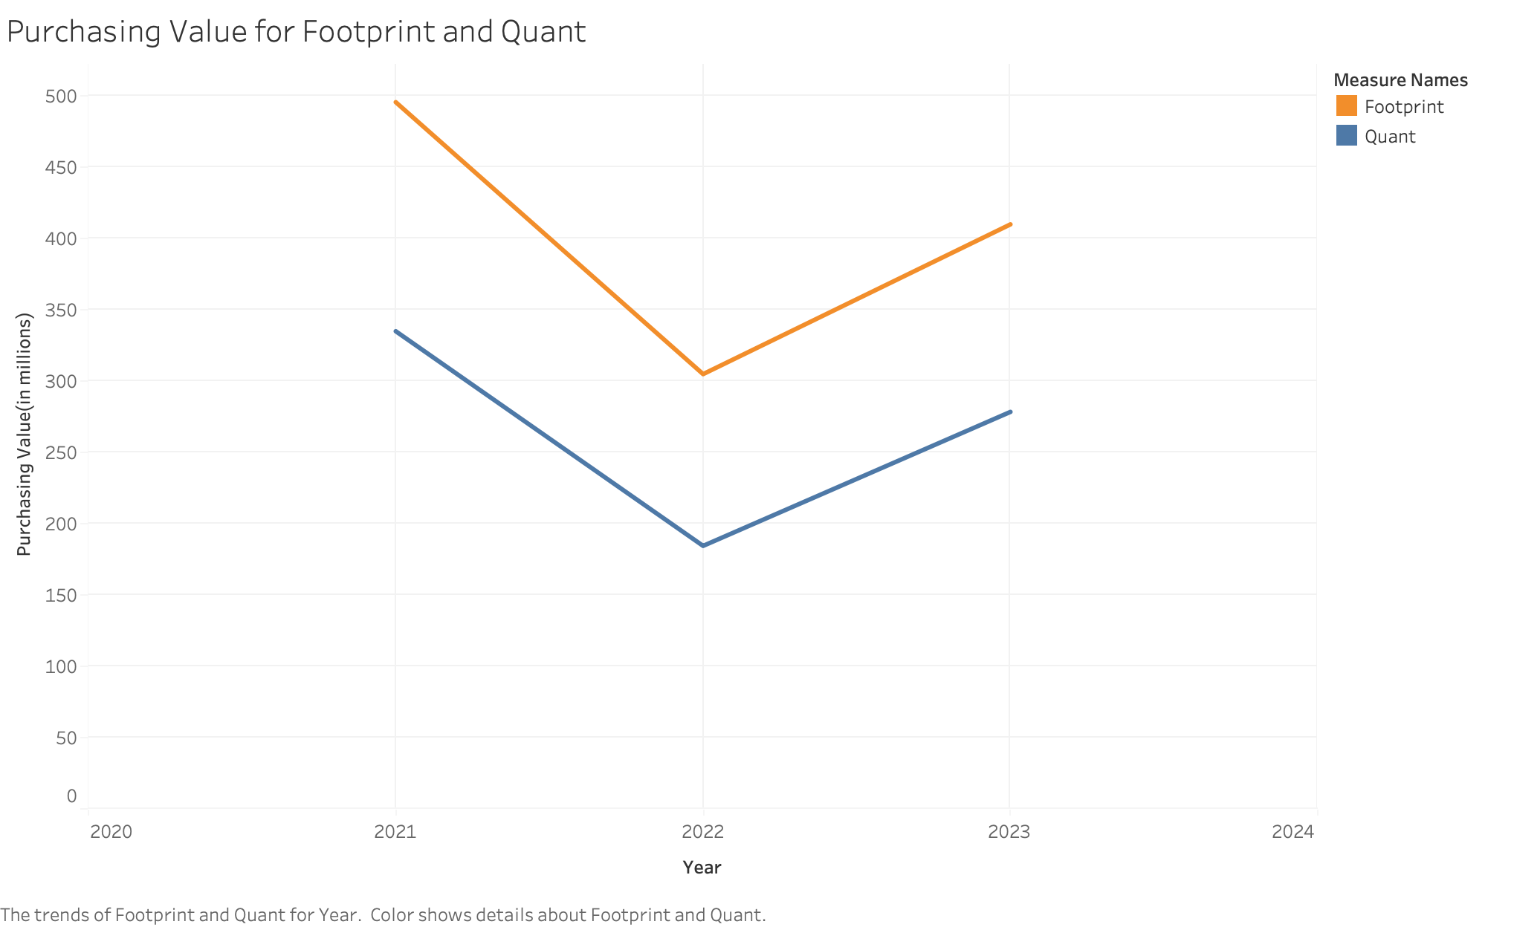
495.6
410.0
335.0
278.4
304.9
184.5
Notes:
The orange line represent the value of Footprint from 2021- Forecast 2023. The Blue line represent Quant. We find the purchasing by using EBITDA time by implied mutiple ( We use Enterprise Value/EBITDA) and other (EBIT) then subtract debt and plus cash which give us the approx purchase price

Slide 17
Bid Pricing
Principal should be willing to pay between 410 and 481 million for Footprint
Similarly, the price range for Quant should be between 278 and 366 million
Footprint minimum asking price is 337 million while Quant’s is 416 million

Slide 18
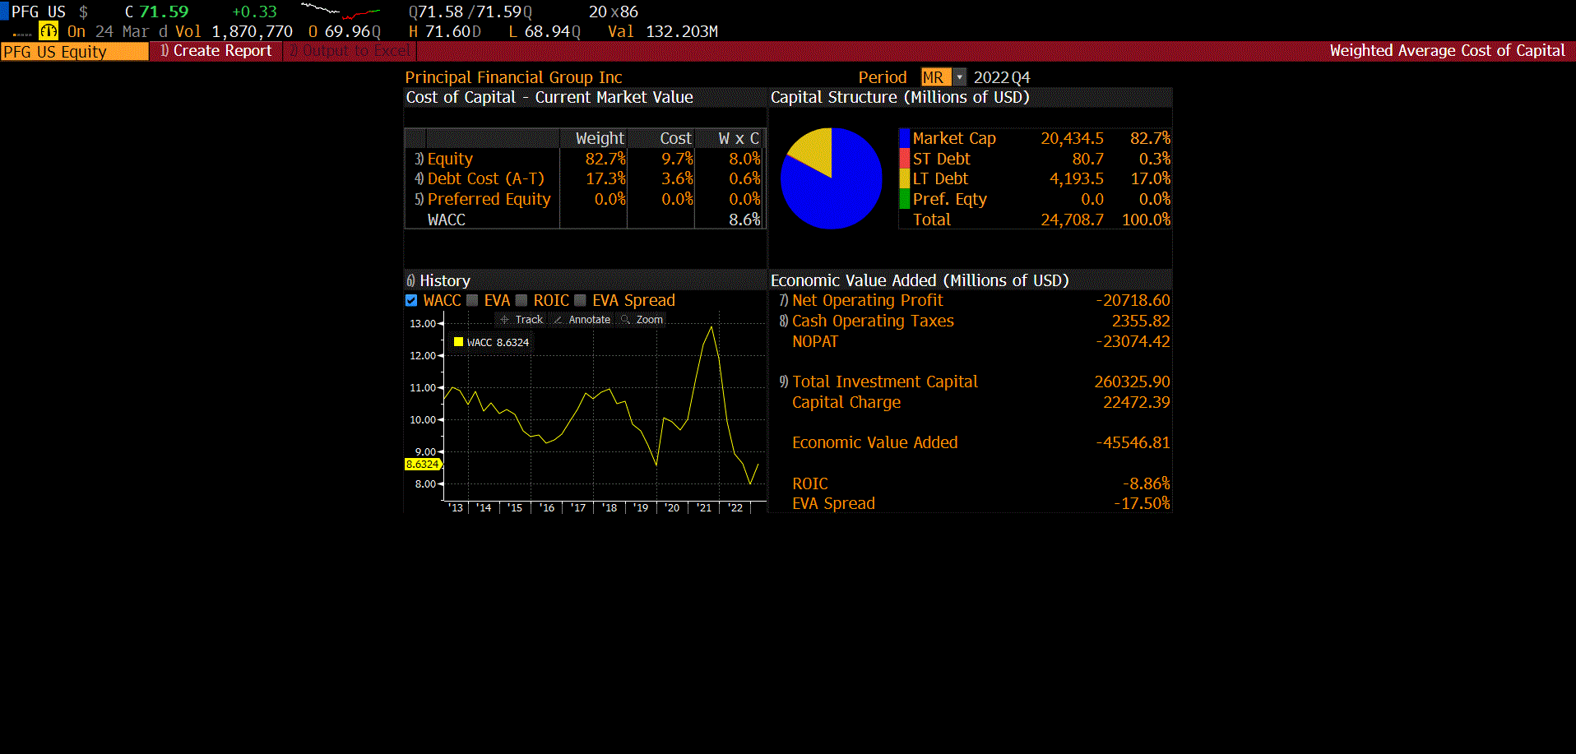
Wacc of principal
Principal’s WACC is 8.6%
Industry average is 7.7%
Principal is in a strong position relative to other firms

Slide 19
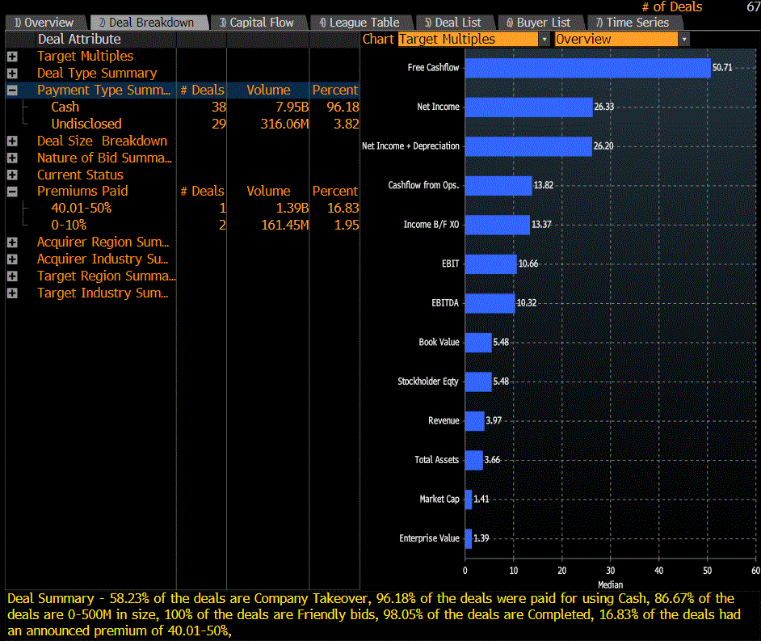
Principal past acquisitions
Principal funded 96.18% of past acquisitions with pure cash.
The remaining 3.82% of acquisitions were undisclosed
Cash remains Principals preferred funding method

Slide 20
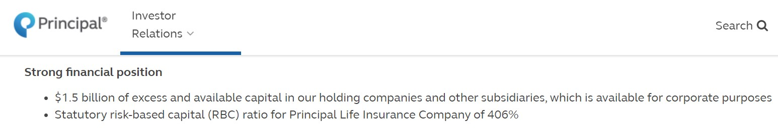
Funding for this Acquisition
January 30th Press Release regarding 2022 numbers
Plenty of excess cash to fund either of the acquisitions
406% RBC, can pay all insurance obligations at least 4 times over

Slide 21
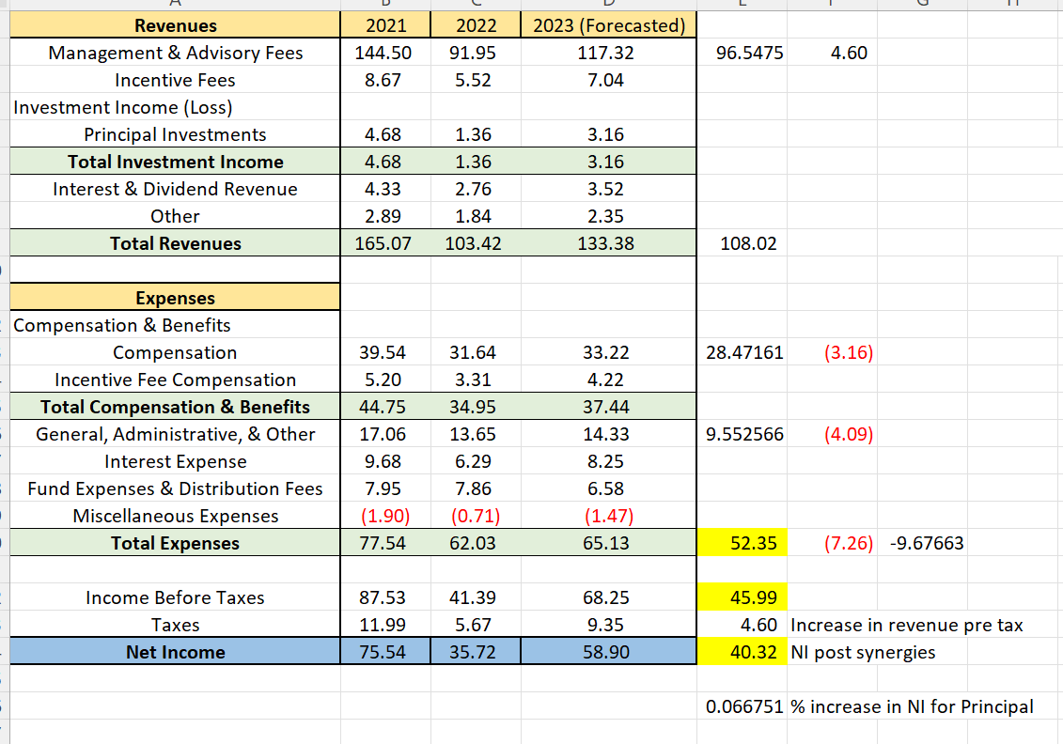
Effect On principal
Adds approximately 46 million to pre-tax revenues
Adds 40.32 million to net income
Overall, 6.67% increase in net income for Principal in 2022.

Slide 22
Conclusion
Principal should acquire Footprint for $409.95 million
Footprint is the clear choice when analyzed through the frameworks
Principal has enough capital to make this acquisiton

Slide 23
Thank you

