Slide 1
Brooks Case Analysis
Daniel Krey, Dan Russell, Jay Ditcher and Jason May

Slide 2
Analysts Bios
Daniel Krey - Senior Finance and Accounting
Dan Russell - Senior Finance and Risk Management Insurance
Jay Ditcher - Senior Finance and Risk Management Insurance/Management
Jason May - Junior Finance and Data Analytics

Slide 3
Recommendations
Submit LOI at $368M for Footprint Asset Management
Depending on response the max for final PSA should be $449M
Offer with no financing contingency but option to receive additional financing
Do not acquire Quant Impact Partners
Don’t want to offer lower than the ask
Don’t want to go under contract and re-trade

Slide 4
Principal Competition
Recent growth in ESG focus and pricing premium
As of December 2021, AUM in ESG funds was $2.7 trillion of which 81% was European and 13% from the United States with $143 billion worth of capital inflows in Q4 ‘21¹
Competing in a lowering cost environment
Passive versus active management - Indexation
Lower fees longer term (perpetuity commitment) goal
Blackrock (0.10% fees with $8.6B AUM)² versus Blackstone (1.5% and 20% with $975B AUM)³
Strategic buyer vs sponsor
As cost of borrowing increases strategic buyers will be more favorable as LBO’s become more expensive
Sponsors may not be able to recognize all the cost synergies

Slide 5
Strategic Competition in ESG
MetLife acquires Affirmative Investment Management - Q4 ‘22⁴
AIM is a ESG focused fixed income investment manager with $1.01 billion AUM
MetLife has $579.8B AUM as of 12/31/22
MAPFRE acquires La Financière Responsable - Q1 ‘23⁵
LFR is a French based mutual fund ESG specialist with €650 million AUM
MAPFRE is headquartered in Spain with €59.6B AUM as of 12/31/22

Slide 6
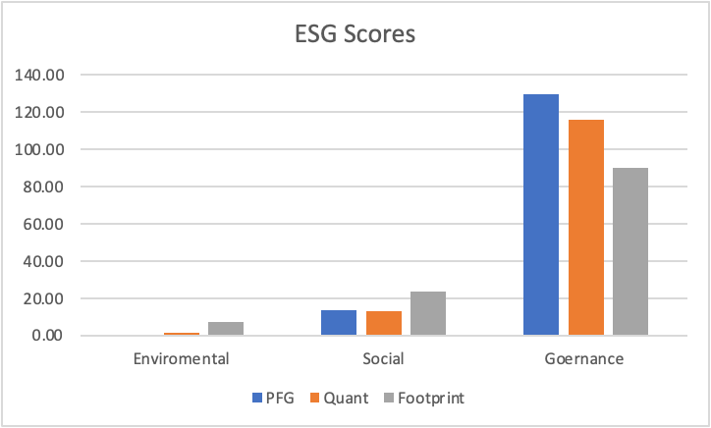
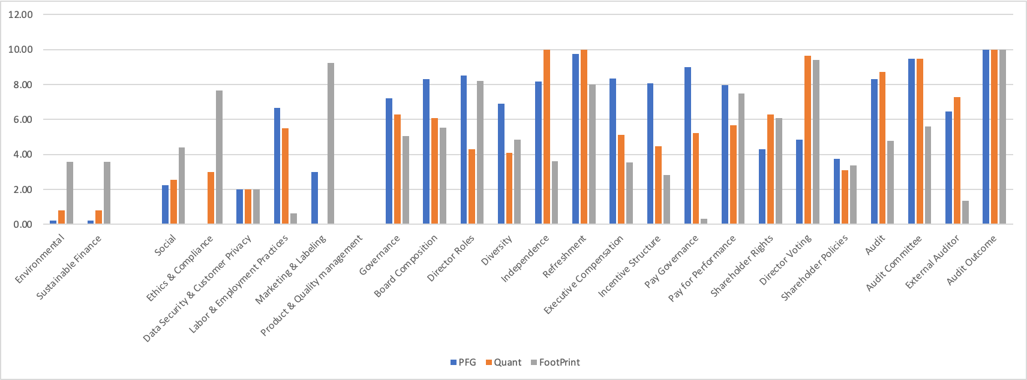
ESG Analysis
Pros/Cons
MSCI Rating: BBB
Risk score:17.22 (low)

Slide 7
Culture Fit
Principal
Purpose: “Foster a world where financial security is accessible to all”
Mission: “Help more people save enough, protect enough, and have enough”
Footprint
Company values/ownership, new opportunities,
Quant
Management team

Slide 8
Financial Analysis Performed
Comparable Transaction Analysis
Discounted Cash Flow Analysis
Considered unlevered returns

Slide 9
Comparable Transaction Analysis Process
Locate comparable universe
Looked at small-cap target firms that focused on ESG investments
Target was acquired by public strategic buyer
Locate necessary financial information
Searched 10-K, proxy statements, press releases, and other public data
Spread key statistics
Benchmark the comparable companies
Determine valuation
Used EV/EBITDA multiple

Slide 10
Comparable Transaction Analysis Findings
EV/EBITDA at asking prices
EV = Asking Price for Equity + Debt - Cash and Cash Equivalents
Quant 9.24 multiple (EV $584.2M / EBITDA $63.24M)
Footprint 8.59 multiple (EV $657.1M / EBITDA $79.47M)
If market multiple of 9 times EBITDA is used
Quant market value of equity $400.9M
Footprint market value of equity $368.4M

Slide 11
Discounted Cash Flow Analysis
Quant
Fair value $365M < $416M ask
Footprint
Fair value $449M > $337M ask
Assumptions
Synergies effect modelled
2% revenue and expense growth
Sensitivity tested -5% retraction to 7.5% growth for both
All cash purchase

Slide 12
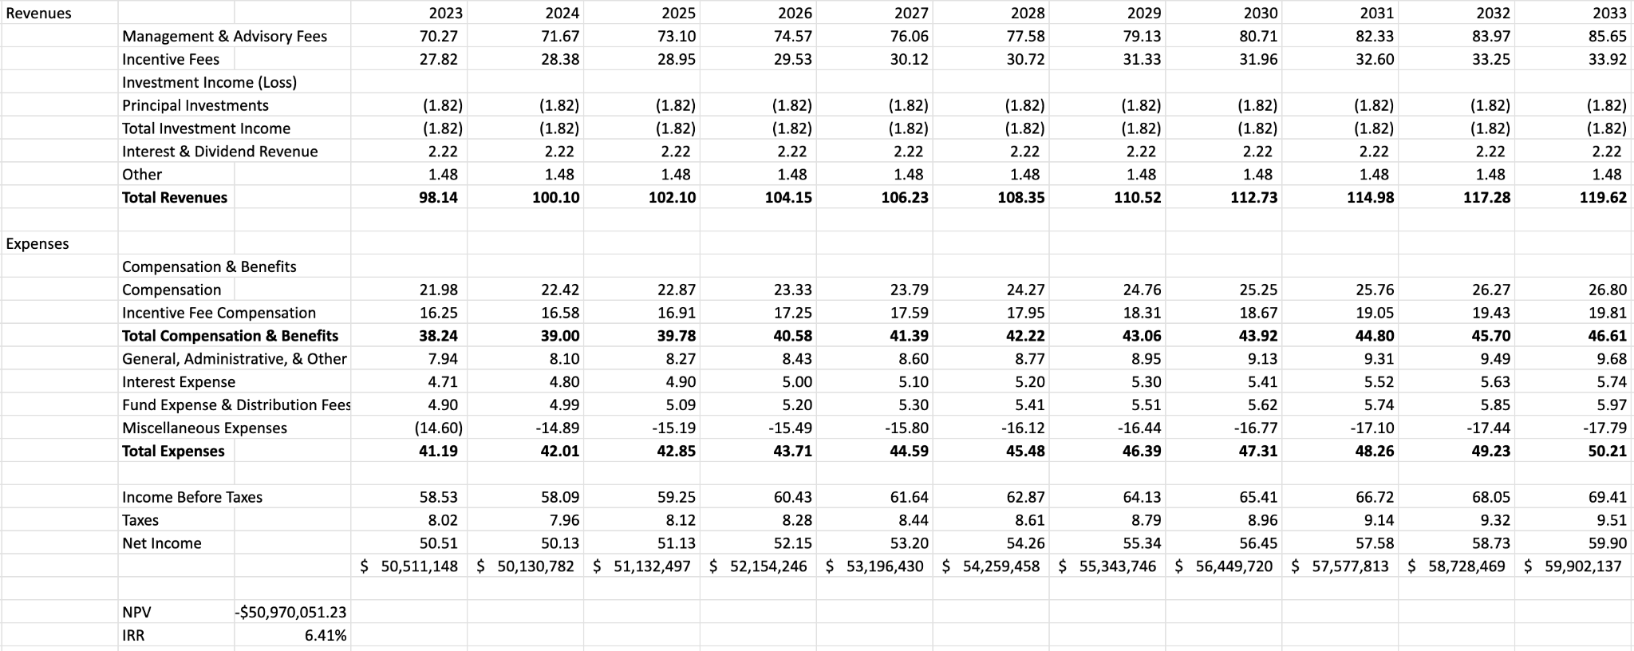
Quant Unlevered DCF

Slide 13
Quant NPV Sensitivity

Slide 14
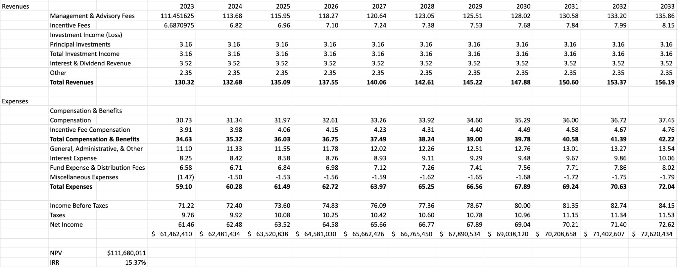
Footprint Unlevered DCF

Slide 15
Footprint NPV Sensitivity

Slide 16
Bidding Strategy - Why $368M?
Offer more than the ask might allow Principal to sign an exclusive agreement with Footprint
Meets constraints for comp analysis and DCF
An unlevered deal is favorable from sellers perspective
Offer would get Principal invited to the second round
Not completely folding cards holding off the top offer for the best and final round if in bidding war with top offer at $449M based on DCF

Slide 17
Conclusion
Bidding $368 million for Footprint would be advantageous to grow Principals ESG outlook
$368 million was from the smaller of comp and DCF valuation
$448 million is the max boundary for DCF
Footprint has complimentary ESG scores

Slide 18
Questions?

Slide 19
References
Bhagat, S. (2022, March 31). An inconvenient truth about ESG investing. Harvard Business Review. Retrieved March 27, 2023, from https://hbr.org/2022/03/an-inconvenient-truth-about-esg-investing#:~:text=Researchers%20at%20Columbia%20University%20and,both%20labor%20and%20environmental%20rules.
Reiff, N. (2022, November 19). How Blackrock Makes Money: Investment and Advisory Fees. Investopedia. Retrieved March 27, 2023, from https://www.investopedia.com/articles/markets/012616/how-blackrock-makes-money.asp
Gara, A. (2021, August 31). How big promises and fat fees turned private equity into a lousy investment. Forbes. Retrieved March 27, 2023, from https://www.forbes.com/sites/antoinegara/2021/08/06/how-big-promises-and-fat-fees-turned-private-equity-into-a-lousy-investment/?sh=203c855b6e34
Franecki, D. (2022, December 15). METLIFE Investment Management completes acquisition of Affirmative Investment Management. MetLife Investment Management. Retrieved March 27, 2023, from https://investments.metlife.com/about/newsroom/2022/december/metlife-investment-management-completes-acquisition-of-affirmative-investment-management/
MAPFRE, R. (2023, March 1). MAPFRE increases stake in LA financière responsable to 51 percent. Noticias Mapfre. Retrieved March 27, 2023, from https://noticias.mapfre.com/en/mapfre-increases-stake-in-la-financiere-responsable-to-51-percent/

