Slide 1


Brooks
Case Competition
MEGHAN BENSON, BLAKE ELLINGSON,
JONATHAN HOLAN, ISAAC HOUSE, MATTHEW NICKEL
TEAM 4

Slide 2
Agenda
  Challenge Overview
  Formal Recommendation
  Financial Considerations
  ESG Evaluation
  Cultural Alignment
TEAM 4

Slide 3
Challenge Overview
Objective: To evaluate two acquisition targets to determine if either should be pursued.
Quant Impact Partners
Footprint Asset Management
  Utilizes a fully quantitative investment strategy
  Beginning to expand ESG-focused offerings
  Established in 2014
  28 current employees
  Specializes in actively managed mutual funds
  Prioritizes an ESG-focused approach
  Established in 1992
  72 current employees
TEAM 4
Notes:
The challenge provided to us was to evaluate two potential acquisition targets and offer a formal recommendation considering ESG metrics, financial factors, and company culture. The two targets were Quant Impact partners, a newer, smaller private firm that utilizes a fully quantitative investment strategy, and Footprint Asset Management, a relatively older firm that specializes actively managed mutual funds and prioritizes an ESG-focused approach.

Slide 4
Formal Recommendation
  Footprint Asset Management at a price of $345M
TEAM 4
Notes:
When considering the potential contributions of each company to Principal’s current ESG metrics--along with the financial feasibility and cultural alignment of each potential acquisition– we recommend that Principal purchases _______ at a price of 337M. While this higher than our calculated value later, the is a premium offered to reflect the value of ESG improvements

Slide 5
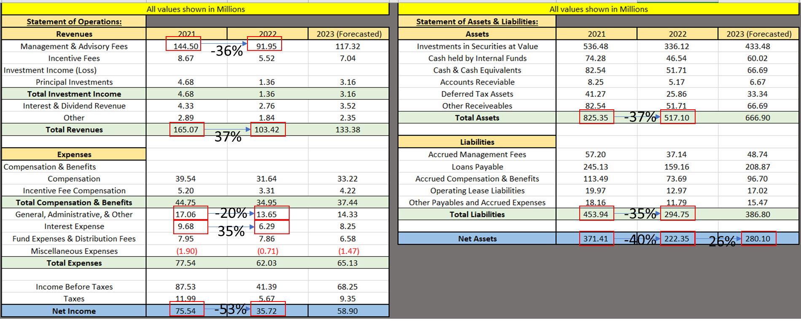
Financial Considerations – Footprint
Fair Value?
Book/Carrying Value?
37% Change (same)
cnsjans
TEAM 4

Slide 6
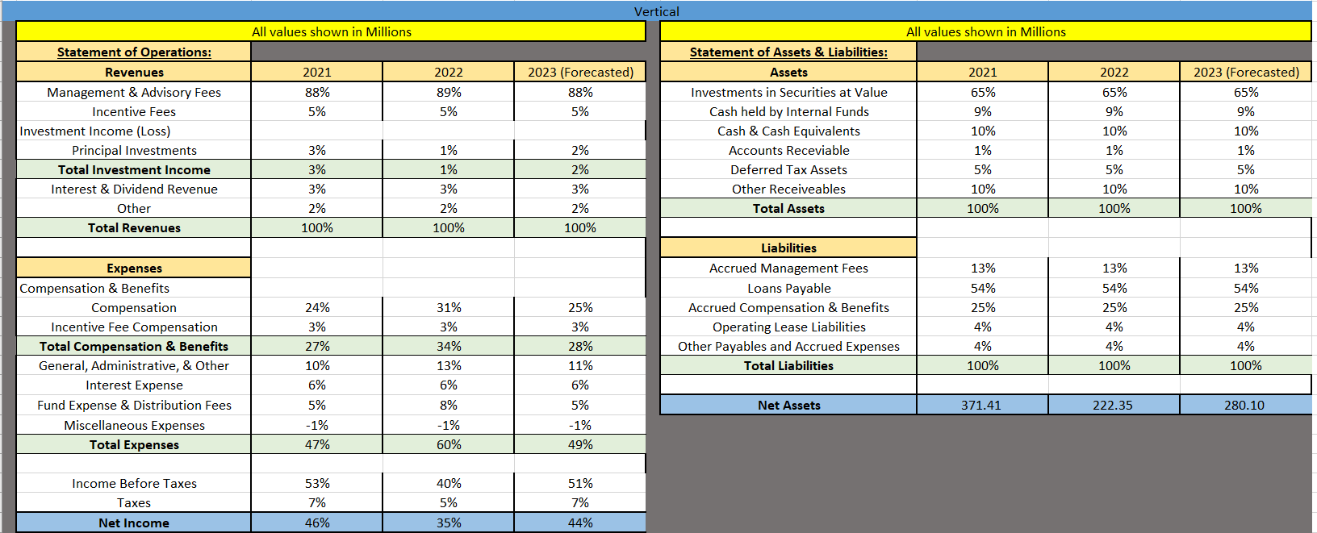
Financial Considerations – Cont.
TEAM 4

Slide 7
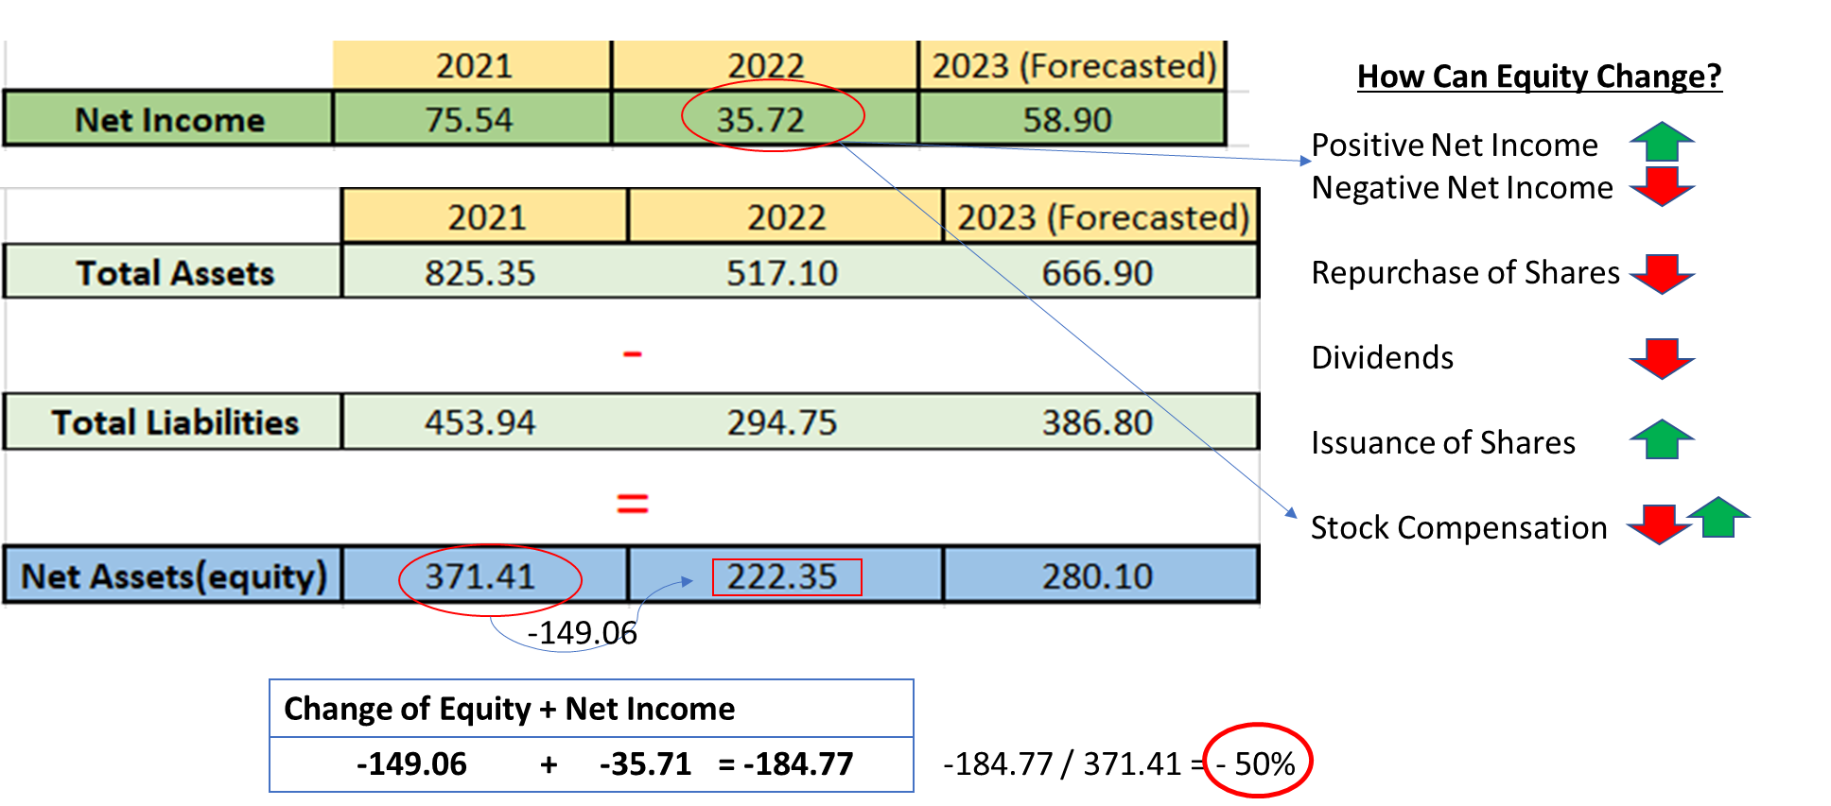
Divestment by the Company
TEAM 4

Slide 8
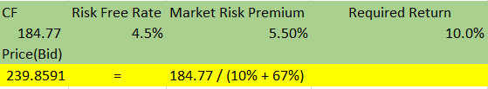
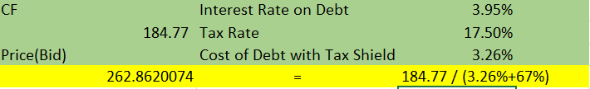
Discount Cash Flows
Ask Price: $337M
Risk Free Rate = 4.5%
TEAM 4

Slide 9
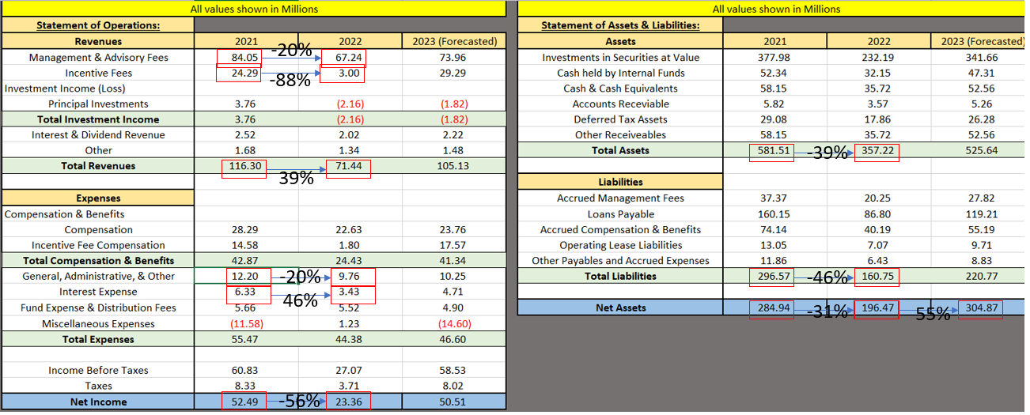
Financial Considerations – Quant
Fair Value?
Book/Carrying Value?
39% Change (same)
TEAM 4

Slide 10
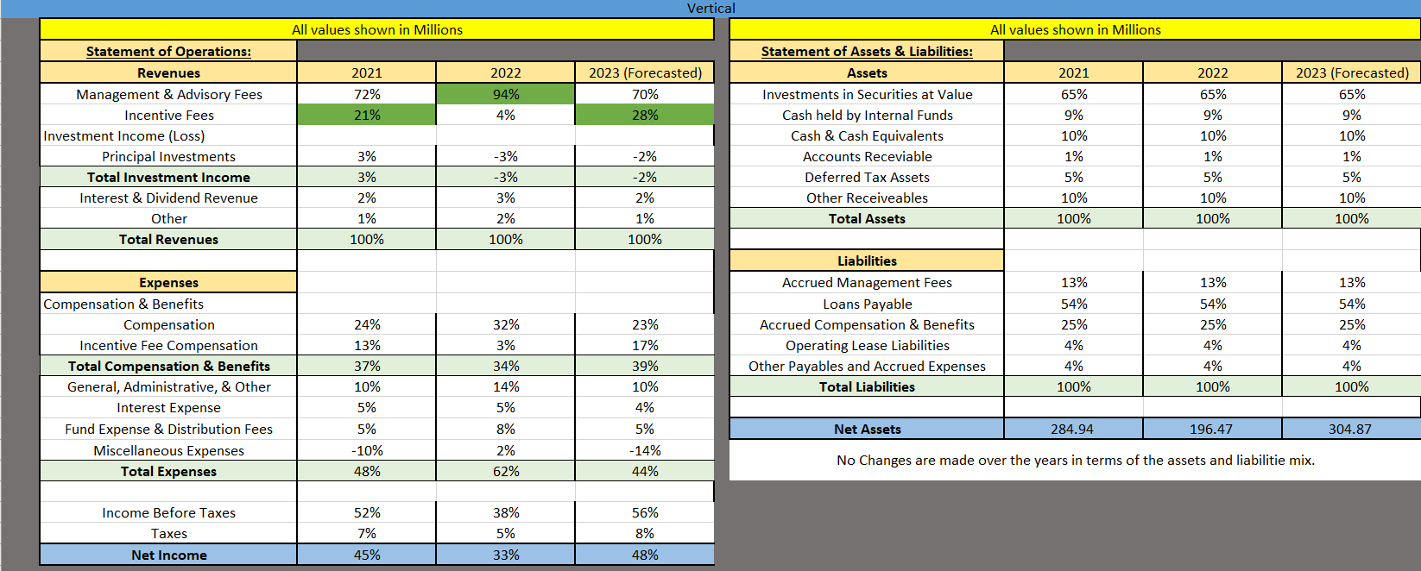
Financial Considerations – Cont.
TEAM 4

Slide 11
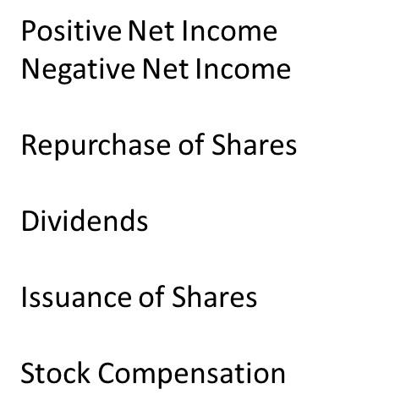


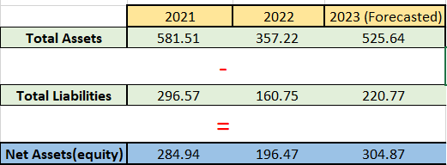
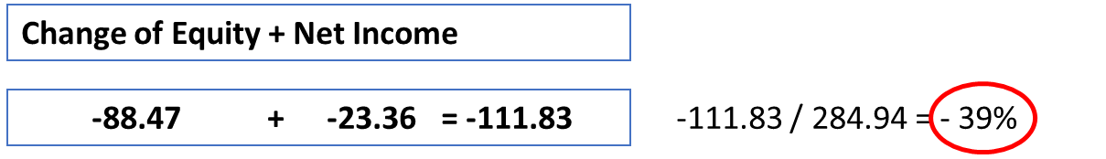
Divestment by the Company
-88.47
TEAM 4

Slide 12
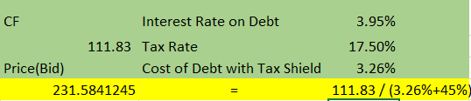
Discount Cash Flows
Ask Price: $416M
Risk Free Rate = 4.5%
TEAM 4

Slide 13
Overall Concerns
Unaudited financial information
Lack of Historical Data (only two years)
No past forecast to compare to when determining accuracy of forecasts
Not in the business of liquidation
Footprint
  50% Liquidation
  Management wants to retire(leave)
Quant
  39% Liquidation
  High employee turnover
TEAM 4

Slide 14
Liquidation Concerns
Liquidation is a sign of lack of profitability
Liquation can also be a sign of assets being worth more than the operating value
Lack of interest in management continuing operations
  Management wants to retire(Footprint)
TEAM 4

Slide 15
Adjustment for Synergies/Erosion
Synergies
  10% Compensation Synergy
  30% General and Administrative Synergy
  75% capture of expected synergy benefits
  ___________________________________
  Net Synergies = 30%
  5% Shock Lapse to Management and Advisory Fees upon announcement of deal (Negative Synergy)
  __________________________________
Net adjustment 25%
TEAM 4

Slide 16
Result of Synergies/Erosion
__________________________________
Net adjustment = 25%
Footprint: 240 M – 263 M
Footprint: 300 M – 329M
Quant: 207 M - 232 M
Quant: 259 M - 289 M
TEAM 4

Slide 17
Financial Recommendations
Offer 300 M – 329 M for Footprint (compensation with vested shares)
Offer 259 M - 289 M for Quant
Generally, only buy if the minimum price of either company goes at or below the range of prices above.
Studies argue that higher ESG scores can reduce cost of capital by 1.14-10%
Assuming 5%: 315M – 345.45M for Footprint
271.95M – 303.45M for Quant
TEAM 4
Notes:
MSCI studies argue that higher ESG scores can reduce the cost of capital for companies by 1.14-10%. As such, we can justify spending more to meet Footprint’s minimum bid to account for the value of improved ESG metrics.

Slide 18
Principal's Financing of Purchase
Cash
Debt
Footprint: 315M – 345.45M
Quant: 271.95M – 303.45M
TEAM 4

Slide 19
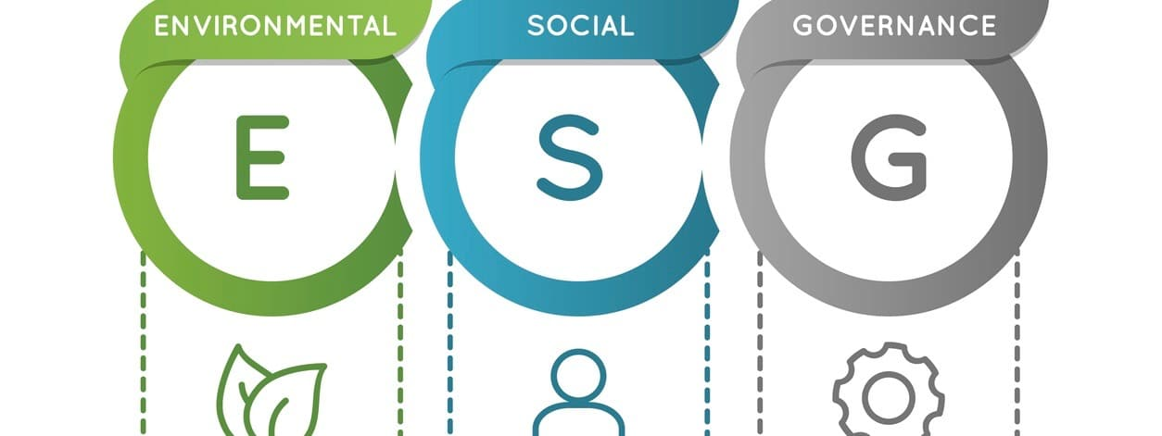
Principal's ESG Vision/Approach
Principal’s ESG Vision: Help people today by advocating for security and inclusion, creating opportunities for future generations
Principal’s Approach to ESG: Grow a sustainable and secure society through long-term, responsible actions.
TEAM 4

Slide 20
ESG Evaluation
Key Components
People
Practices
Products & Services
Employee Management
Employee resources
Global inclusion
Financial education
Environmental Impact
Ethics
Risk Management
Sustainable resourcing
Consumer & Product impact
Financial Inclusion
Responsible Investing
TEAM 4

Slide 21
Footprint's Pros and Cons of ESG Practices
Pros
Cons
Principal's employee build up. Footprint's retirement is an opportunity.
Managers who are retiring or seeking employment elsewhere will forfeit a portion of their equity-based compensation for not joining Principal. May result in managers who do stay only for doing so for the compensation.
No recent turnover in key positions
Assuming current owners of Footprint will take the buyout of shares
TEAM 4
Notes:
for not only current Principal employees to advance but to also implement their own strategy with a newer workforce.

Slide 22
Quant's Pros and Cons of ESG Practices
Pros
ESG Centric
Actively Seeking Growth and Diversity
Cons
Turnover in key roles
Potential social friction
TEAM 4

Slide 23
ESG Metrics
Principal/Footprint/Quant
Environmental: Footprint’s score in this category is significantly higher than both Quant and Principal.
Social: Footprint is dominating Ethics & Compliance as well as Marketing and Labeling within the Social aspect of ESG.
Governance: Principal leads in governance primarily due to their executive compensation and board composition.

Slide 24
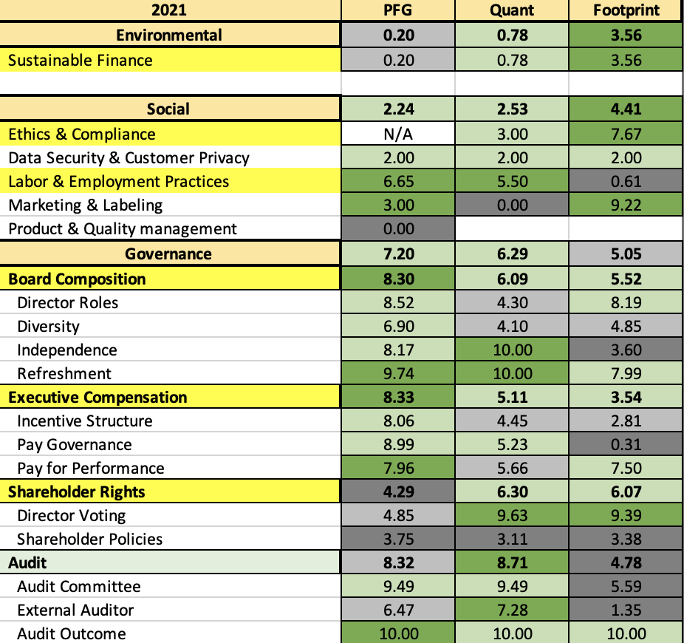
ESG Composite Scores and Principal's ESG Strategy
Principal: 55.54
Footprint: 44.95
Quant: 44.63

Slide 25
Cultural Alignment
Principal's Priorities
Mission
Purpose
Values
To help more people save enough, protect enough, and have enough
To foster a world where financial security is accessible to all
  Start with the customer
  Do what's right
  Own what's next
  Invest for our future
TEAM 4
Notes:
Meghan :
When looking at the acquisition of a company, a necessary factor is the cultural compatibility of the two companies. As such, we looked at Principals values and intentions within the industry, to then compare with the two acquisition targets. Principal’s mission statement is ….. Principal purpose is…….. Principal values the prioritization of the customer, doing the right thing, embracing and implementing future changes in the industry, and with that taking purposeful action to secure Principal’s future wellbeing.

Slide 26
Cultural Alignment
Footprint Asset Management
Strengths
Weaknesses
Prioritizes “investing for good”
Demonstrated through their expansion of ESG-focused products
Active investment in greener technologies
Further development of international funds
Lower governance metrics
Loss of key personnel’s equity-based compensation
Larger company
TEAM 4
Notes:
Meghan:
Upon evaluating Footprint’s cultural aspects, there were clear strengths and weaknesses.

Slide 27
Cultural Alignment
Quant Impact Partners
Strengths
Weaknesses
Newer, smaller company
“Fossil Fuel Free” investment policy
Extremely high employee turnover rates
Non ESG-focused funds fail to consider ESG data points
TEAM 4
Notes:
Meghan

Slide 28
Thank you!
MEGHAN BENSON, BLAKE ELLINGSON,
JONATHAN HOLAN, ISAAC HOUSE, MATTHEW NICKEL
TEAM 4

