Slide 1
Brooks Case Competition
Analysis of Company Acquisition for Principal Financial Group
By, Nathan Park, Nathan Gupton, Michael Santoro, and Augustine Quintero

Slide 2
Agenda
Recommendations
Acquire Footprint Asset Management
How to Finance
Fair Valuation
DCF Model
Valuation of Comparable
Financial Ratios
ESG Strategy
ESG Investing Pros and Cons
ESG Score Analysis
Acquisition Impact on Principal
Run-Rate Pro-Forma financials
Concerns
Cultural Fit
Comparison of ideology
Summary
Key Points
Notes:
Augustine
Comparison of ideology between Principal Financial Group, Quant Impact Partners, and Footprint Asset Management

Slide 3
Recommendations
Notes:
Augustine

Slide 4
Acquire Footprint Asset Management
We recommend that Principal Acquires Footprint Asset Management for their minimum bid of $337 Million.
We also believe Footprint Asset Management will fill the gaps in principals ESG scores.
Values retaining employees like Principal.
Notes:
Augustine
Our valuation puts that bid almost $300 million undervalued
Quant Impact Partners is also undervalued but acquiring both would be too harmful to diversification

Slide 5
How to Finance this acquisition?
Principal recently issued $700 million in new bonds on March 8th.
They can use $337 Million of it to finance the acquisition of Footprint Asset Management.
If the money was already used elsewhere, we believe they should use equity to finance the capital needed.
Equity in 2022 was $10.3 Billion compared to $16.458 Billion in 2021

Slide 6
ESG Strategy

Slide 7
ESG Investment Management
Pros
Cons
Can create ESG funds that are still demanded while having higher operating fees.
"Greenium"
Increased community and Customer Engagement.
Long-Term Positioning.
No clear ESG standards in the U.S.
Will have to be picky on what to include in a portfolio.
May become under-diversified.

Slide 8
ESG Comparisons
Footprint Asset Management
Quant Impact Partners
Principal Financial Group
Pros
Heavy Emphasis on Social and Environment Factors.
Very eco-friendly financial objectives and investing strategies.
Excels in the social side of ESG.
High ethics, compliance, and marketing.
Cons
Weak Governance Scores.
Low board diversity and independence
Questionable pay, shareholder policies, and audit management.
Pros
Uses internal models that consider environmental, social, and governance data points.
Employs a "fossil fuel free" investment policy.
Great labor practices.
Cons
Weak marketing related to ESG.
Low Diversity scores.
Shareholder policies need amending.
Pros
Employs tremendous labor practices, leading ESG rating
Has a high ESG score for pay and compensation
Large-cap firm that is already well in ESG strategy and investing.
Cons
Lacks in sustainable financial methods
Has weak shareholder rights

Slide 9
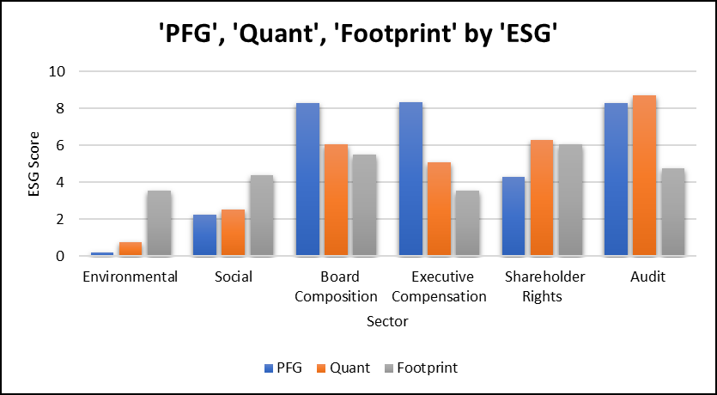

Slide 10
Cultural Fit

Slide 11
Cultural Comparisons
Footprint Asset Management
Quant Impact Partners
Principal Financial Group
Superior customer involvement and communication.
Diverse and long-standing customer base.
Takes pride in employee retention and low turnover.
Industry leader in tenure of fund managers.
Believes in investing for good.
Hyper focus on improving broad social factors.
Very quantitatively oriented.
High turnover rate within the past year.
Significant surprise departures.
Very concentrated customer base.
Highly customer-oriented.
Practices high employee retention and development.
Integrity, inclusion, and honesty.
Strong belief in giving back to communities.

Slide 12
Fair Valuation of Footprint Asset Management and Quant Impact Partners
Notes:
Augustine

Slide 13
Inputs used in the DCF model
Expected Performance
Revenue Growth
3% growth in revenue YOY for both companies.
Total Compensation
Average growth percentage rate was found by using 2021-2023 data and applied it YOY
36.24% Quant Impact Partners
29.77% Footprint Asset Management
SG&A Expense
The 2023 projected growth was used as constant growth YOY.
3.79% Quant Impact Partners
4.98% Footprint Asset Management
Miscellaneous Expenses
The average amount from 2021-2023 data was set at a fixed amount YOY
Net Cash Flows
Calculate EBIT from expected performance
Apply a tax rate of 13.7% to EBIT
Subtract tax amount from EBIT to get Net Income
Financial data for 2021-2023 were changed to reflect assumed acquisition synergies.
The data with reflected synergy was then used with our calculated expected performance metrics for each company.
Amount | Description
10% | Compensation Synergy
30% | General and Administrative Synergy
75% | capture of expected synergy benefits
-5% | Shock Lapse to Management and Advisory Fees upon announcement of deal (Negative Synergy)
Notes:
Augustine
Miscellaneous Expenses is a combination of interest expense, fund expense & distribution fees, and miscellaneous expense as seen on the income statement for each company.

Slide 14
WACC Calculation
Index Fund | Benchmark Used
Footprint Growth | Russell 1000® Growth Index
Footprint Value | Russell 1000® Growth Index
Footprint Mid Cap | Russell Midcap® Index
Footprint Fixed | Bloomberg U.S. Aggregate Bond Index
Footprint Real Estate | MSCI U.S. REIT Index
Used Covariance(Fund, Benchmark) / Variance(Benchmark) to get Beta.
Got the portfolio Beta by taking the weighted average of Beta's based on AUM in each fund.
Used this Beta to get the company’s WACC.
Cost of Debt is the Risk-Free Rate + Spread Indication.
Index | Benchmark
QI International | MSCI EAFE NTR Index
QI Large Cap | Russell 1000® Growth Index
QI Mid Cap | Russell Midcap® Index
QI Small Cap | Russell 2000® Index
QI Balanced | Principal Diversified Income Fund
QI Bond | Bloomberg U.S. Aggregate Bond Index
QI Income | Bloomberg Credit 1-3 Year Index

Slide 15
Valuation Method
Used the Companies 2021-2022 and forecasted 2023 data to project cash flows through 2028.
NPV at respective companies WACC.
Perpetuity method of calculation for cash flows after 2028.
Added in Cash and subtracted long-term debt from the 2023 balance sheet.
$633,288,089.85 valuation for Footprint Asset Management.
$630,969,041.60 valuation for Quant Impact Partners.

Slide 16
Valuation of Comparable
Quant Impact Partners | Valuation Factor | Footprint Asset Management
4.05x | Enterprise Value to Sales | 4.05x
$425,770,000 | Enterprise Value | $540,190,000
1.72x | Equity Multiplier | 2.38x
.2 | Asset Utilization | .2
61% | Profit Margin | 72%

Slide 17
Acquisition Impact on Principal

Slide 18
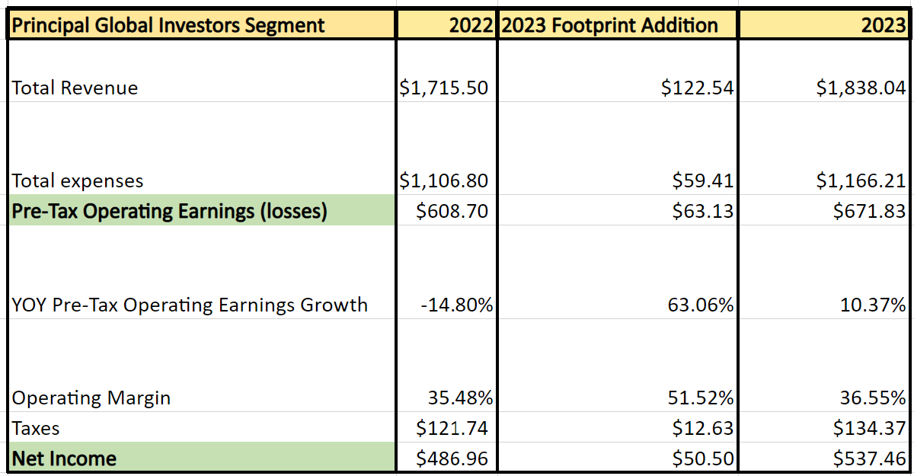
Financial Impact
Operating Revenue growth is above their long-term target of 4-7%
Operating Margin is in their long-term target of 34-38%
Cash Flow Growth of 10.4%

Slide 19
Summary

Slide 20
Key Points
ESG investing is a growing field, expected AUM growth of 5% till 2026.
Footprint Asset Management makes Principal a more complete and well rounded ESG company
Culturally both Principal and Footprint believe in investing in employees to develop and maintain customer relations
Footprint minimum bid is nearly $300 million below our valuation of them
Financing options available are through newly issued debt or equity if debt is committed elsewhere
Footprint matches Principals goals for operating margin and YOY revenue Growth

Slide 21
Questions?

